Slide 1
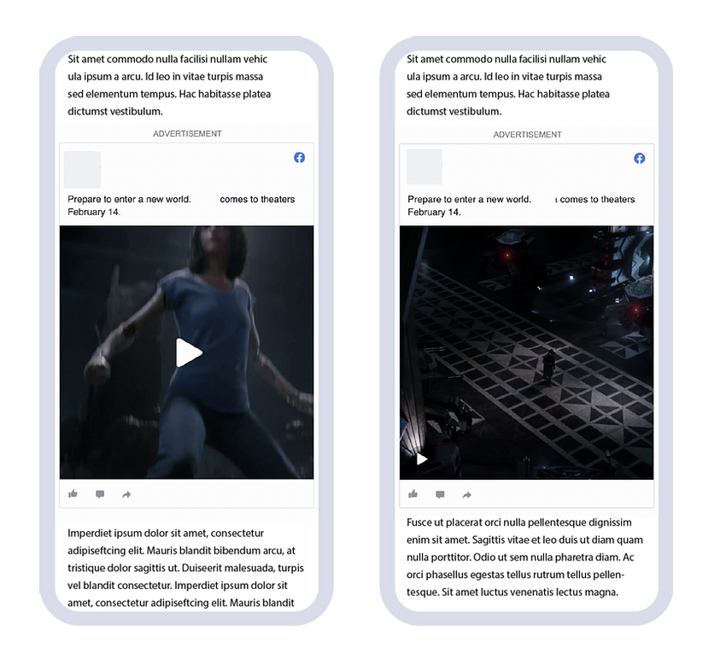
Case Study: Purchase
Film brand increases movie ticket purchase intent through impressions, viewable CTR, and in-view time.
1. Objective
Leading up to the movie release, this film brand wanted to increase ticket sales through their display ads.
2. Solution
This film brand was able to increase sales intent, awareness of the movie, and likelihood of customers to talk about the movie with family and friends.
3. Results
The brand saw 75 thousand impressions, a viewable CTR of 1.44%, and 13.7 seconds average in-view time.
`
75k
1.44%
13.7
Impressions
Viewable CTR
In-view time

